Slide 1
PSAS Launch Tower Upgrade
System Overview
Created By: Richard Witherspoon
Created On: April 19th, 2012
Last Updated By: Richard Witherspoon
Last Updated: June 18th, 2012

Slide 2
Launch Tower Goals
Create system that can have any Linux computer put as controller.
I/O management through USB external to control computer.
Launch via relay interlock from rocket and ground control.
Disconnect power to rocket
Manage visual and auditory signaling.
System should NOT function with loss of computer capabilities. Fail to Safety!
Control computer physical access if lost through Wi-Fi
Ample cooling and dust management
Trigger video acquisition of takeoff.

Slide 3
TO DO
FULL PUNCHLIST
--------------------
- Ignition Board -
Select & Purchase the LIPO chargers
Get dimensions of LIPO batteries
Adapt Ignition board for LIPO on-board
Select diodes and LEDs
- Power Board -
Add circuitry for umbillical on power board
Select and purchase 5v and 19v DC/DC converters
Modify power board for DC/DC converters
Select diodes and LEDs
- LTC Box -
Dimension parts and figure layout in box
Get dimensions for solar charger
Figure out exact connections needed
Figure out how to route wires
Find a box that meets the dimension requirements
- BeagleBoard -
BeagleBoard - make script to launch webservice at boot - instead of manual start
BeagleBoard - Remove apache
- Phidgets -
Application - add error handling and logging
Get annemometer and wind vane to setup the environmental tacking
Figure out wire lengths and mountings for sensors on the tower (wind and temp)
- Other -
Wiki The setup of everything - in progress

Slide 4
Block Level Design
Video Cam(s)
Visual Signal
USB i/o
Interface
Interlocked
Launch Relays
Audio Signal
Thermistors
Wi-Fi Control
Video
Storage
Power Monitoring
Control Computer
R
O
C
K
E
T
Solar Panels
Recharge
Module
Batteries
Power Interface

Slide 5
Interlocks - CURRENT
BATTERY
Rocket OK
Rocket OK
BYPASS
Shorted to stop any signal path
If no rocket wire – a short acts as though its OK to launch
Shorted to allow fire (@ launch it doesn’t matter cause launch happened)
Launch Box
R
O
C
K
E
T
Arm Switch
Gnd Control
OK Relay
light
Igniter breakout
Away Box
Must be jumpered to allow fire – makes connection
Aligator Clips
LAUNCH TOWER COMPUTER KILLS POWER TO ROCKET BEFORE LAUNCH

Slide 6
Interlocks - NEW
BATTERY
Rocket OK
Rocket OK
BYPASS
If no rocket wire – a short acts as though its OK to launch
Shorted to allow fire (@ launch it doesn’t matter cause launch happened)
Launch Box
R
O
C
K
E
T
Arm Switch
Gnd Control
OK Relay
Shorted to stop any signal path
Igniter breakout
Away Box
light
Must be jumpered to allow fire – makes connection
Aligator Clips
LAUNCH TOWER COMPUTER KILLS POWER TO ROCKET BEFORE LAUNCH

Slide 7
Computer Steps
Boots Up
Connects to USB i/o interface
Starts web server and SSH access
Starts launch management software
Starts drivers for webcam access
Login from ground control (via SSH or web access)
View program interface for status and ability to launch.

Slide 8
Software Goals
Take input to begin countdown
Allow halt/cancel of countdown
Report on system status
  Batteries
  Solar Cell
  Relays
  Cameras
Launch sequence
  Start video collection – via GPIO to 3rd-party board (and some form of validation back in)
  Set relays
  Sound horns
  Visual alert
  Send fire signal – This last step must be done again by ground control – NOT automatically in the loop
  Send signal to disconnect shore power to rocket

Slide 9
Software Structure
Launch Control
Software
Access items by their name: alarm, temperature, etc…
High-Level
Restful API
Low-Level API
(manufacturer)
Access items by their pin: pin 1, pin 2, etc…
USB i/o
Interface
Sensors

Slide 10
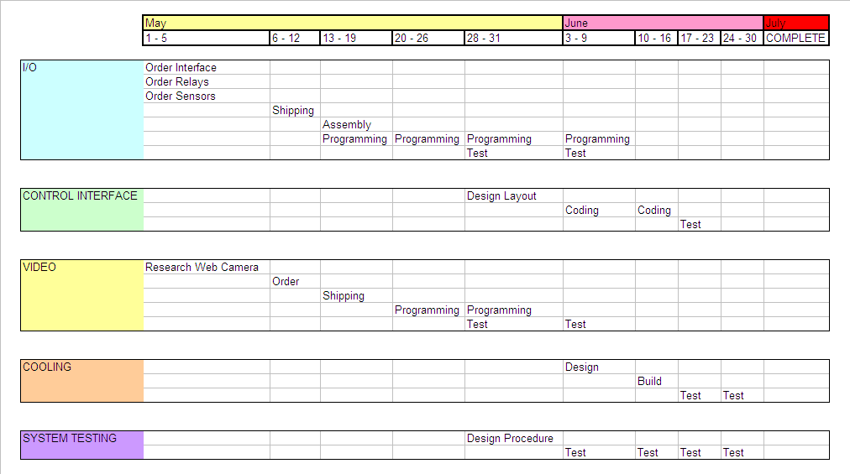
Timeline

Slide 11
Possible I/O Interfaces
Phigets
  Website: http://www.phidgets.com/
  Pros
    Lots of libraries in many languages
    Relays, IO, and webcams all with libraries
    Lots of sensors with libraries (immersive heat up to 800*C – in the plume)
    Debian board for integrated development
Electronics-DIY
  Website: http://electronics-diy.com/USB_IO_Board.php
  Pros
    Super low-cost - $23
    Access control/logging via PHP
    16 individual microcontroller I/O pins
    500mA for electronic projects
Audrino
  Website: http://www.trossenrobotics.com/p/arduino-duemilanove.aspx

Slide 12
Budget - $500
USB i/o interface
Web Cameras
  Under plume
  Wider take-off shot
Sensors
  Plume Temperature
  Power status
  Thermal Status – Electronics
  Thermal Status – Ambient Air
Siren
Lights
Computer system
  NetPC with cooling
  Thermally hardened computer – Ideal Range (30*F - 150*F)
Cooling
  Some form of cooling for electronics
Dust mitigation

Slide 13
Physical Connections
Relay
DC-DC Converter
Rocket Power 19v
+
-
Sys
Pwr
Arm
?
amp
+
-
X
Ignition
Batt
System Power
Solar Batt
+
-
Away Box / Ignition
Solar Panel
LTC Batt

Slide 14
Box Mounting
1.25" diameter steel tubing with heavy galvanization
NEMA plastic box with rain
resistance and dirt protection.
Mount with U-bolt and bolt saddle
so box edge not tight to tube.
All connections panel mounted
through bottom – and through
rubber seals (including wi-fi)
Need some form of strain relief
on the cables hanging

Slide 15
Block Diagram
Various Sensors
(Phidget Powered)
Temp/Humidity
Temp
Voltage - umbilical
Voltage – Ignition Batt
Voltage – System Batt
Voltage - solar
Quad Relay Board
(USB Power)
vBatt to 5v DC-DC
I/O – 8/8/8 + 6usb
(6v – 15v power) to vBatt (12v)
Rocket Ready Relay Board
(Andrew)
Wi-Fi
Control Computer
(5v @ 1.5amp)
Fire signal out to rocket
Serial out to rocket
vBatt to 5v DC-DC
Power out to rocket
vBatt to 19v @ 5-10 amp DC-DC

Slide 16
I/O Design - Phidgets
Temp - Electronics
A – in (1)
Accelerometer
USB – in (1)
D – out (1)
Temp/Humidity - Ambient
A – in (2)
Wind - Direction
USB – in (2)
D – out (2)
A – in (3)
Quad Relay
USB – in (3)
D – out (3)
A – in (4)
USB – in (4)
D – out (4)
Voltage – Umbilical
A – in (5)
USB – in (5)
D – out (5)
Voltage - Solar
A – in (6)
Web Camera (monitoring)
USB – in (6)
D – out (6)
Voltage - Batts
A – in (7)
D – out (7)
Voltage – Ignition
A – in (8)
D – out (8)
Wind - Speed
I/O – 8/8/8 + 6usb
Control Computer

Slide 17
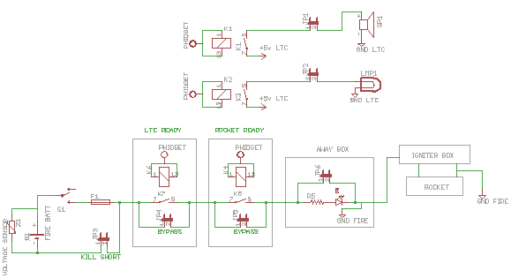
IGNITION PATH & FEATURES
Siren and light need to pull power from system battery so they don’t drain ignition battery.
Pull jumpers to disable feature.
Ability to bypass needing rocket ready or computer signal. Good for testing or bypassing equipment failure.

Slide 18
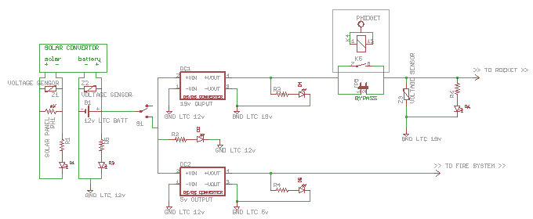
SYSTEM POWER

Slide 19
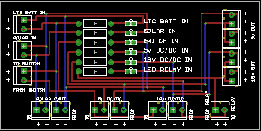
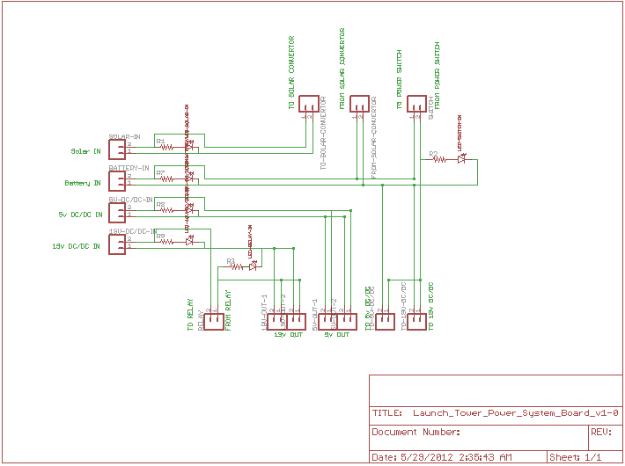
Possible Power Interface Card
Puts all power connections onto one monitoring card with LEDs so you can see if everything is functional right after hook-up.

Slide 20
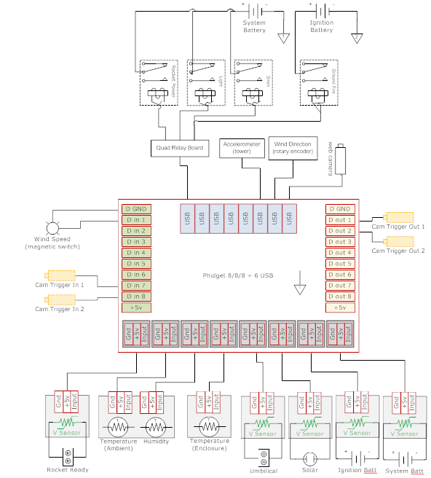
Circuit - Phidget
DPDT on rocket ready
to Digital i/o
x

Slide 21
ROCKET
Rocket Ready
Rocket Umbilical
V_{UMBILICAL (24v)}
V_{IGNITION}
Ignition Board
IGNITION BATT
~14.8v (3.7v * 4)
4S1P
Phidget Relay
V_{UMBILICAL (24v)}
Charger
RS232
CHARGER
usb
WiFi
usb
Phidget Interface
BeagleBoard
Rocket Ready
usb
V_{SYSTEM (5v)}
V_{LTC}
V_{SYSTEM (5v)}
Horns/Lights
Power System
(common ground)
V_{LTC}
V_{UMBILLICAL (24v)}
PV
Charger
5v DC/DC
Beagleboard
5v 950mA – no HDMI monitor attached w/ wireless keyboard
Ignition Board – 5v 100mA (?)
Murata OKI-78SR-5/1.5-W36-C
5v DC/DC 5V 1.2A * (factor) = 2amps
24v 3amp DC/DC
Phidgets
12v 200mA (all relays triggered)
V_{BATT}
V_{LTC}
Charger19v SPS
DC/DC Converter
LTC BATT
~12.6v

